Slide 1

Global Disease Biology Intro University of California, Davis
Orientation 2020| Freshman & Transfer Students| Introduction to the major

Slide 2
Your advising team:
Title | Name | Email addresses
Department Chair | Dave Rizzo | dmrizzo@ucdavis.edu
Master Advisor | Johan Leveau | jleveau@ucdavis.edu
Academic Advisor | Andrea Guggenbickler | amguggenbickler@ucdavis.edu
Academic Advisor & Course Administrator | Francesca De Las Alas | frdelasalas@ucdavis.edu
Peer Advisors | Bianca Arao | blarao@ucdavis.edu
 | Austin Dalmasso | amdalmasso@ucdavis.edu
 | Brandon Nguyen | bvnngyen@ucdavis.edu
Notes:
Insert a map of your country.

Slide 3

What does each role do?
Department Chair:
The department chair handles the daily running of the Plant Pathology department. Dr. Rizzo is also the founder of the GDB major, and is happy to meet with students to discuss academics, research, etc.
Master Advisor:
Like the department chair, the master advisor can also offer perspective on academics and research. Additionally, they will approve any exceptions with the GDB curriculum, and will oversee the submission of practicum projects.
Academic Advisor:
This is your main point of contact for your major requirements and questions. Your major advisor can advise on graduation requirements, degree certifications, resource referrals, and academic or personal difficulties you may face.
Peer Advisors:
These super knowledgeable GDB students are your go-to for all academic plans, general GDB questions, practicum help, and student perspective!
Dean’s Office Advisors:
The advisors in the CA&ES Dean’s office are here to help with GE inquiries, personal and academic difficulties, Late Drop requests, resource referrals, and academic difficulty/ trouble questions.

Slide 4
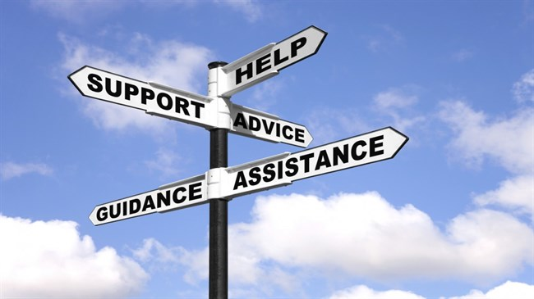
The best way(s) to contact your advising team:
1. Email gdb-advise@ucdavis.edu
This will put you in communication with the entire team, and ensure a faster response
2. Email your major advisor directly
Remember: your major advisor gets hundreds of emails a day, so this response may be slower
3. Access the GDB website or orientation canvas site for answers to FAQs
Accessible 24 hours/day, 7 days/week! We try to put as much information here as possible!
4. Come by 150 Hutchison Hall for face-to face advising
We are available 9am-4pm, M-F
Notes:
Insert a picture of one of the geographic features of your country.

Slide 5
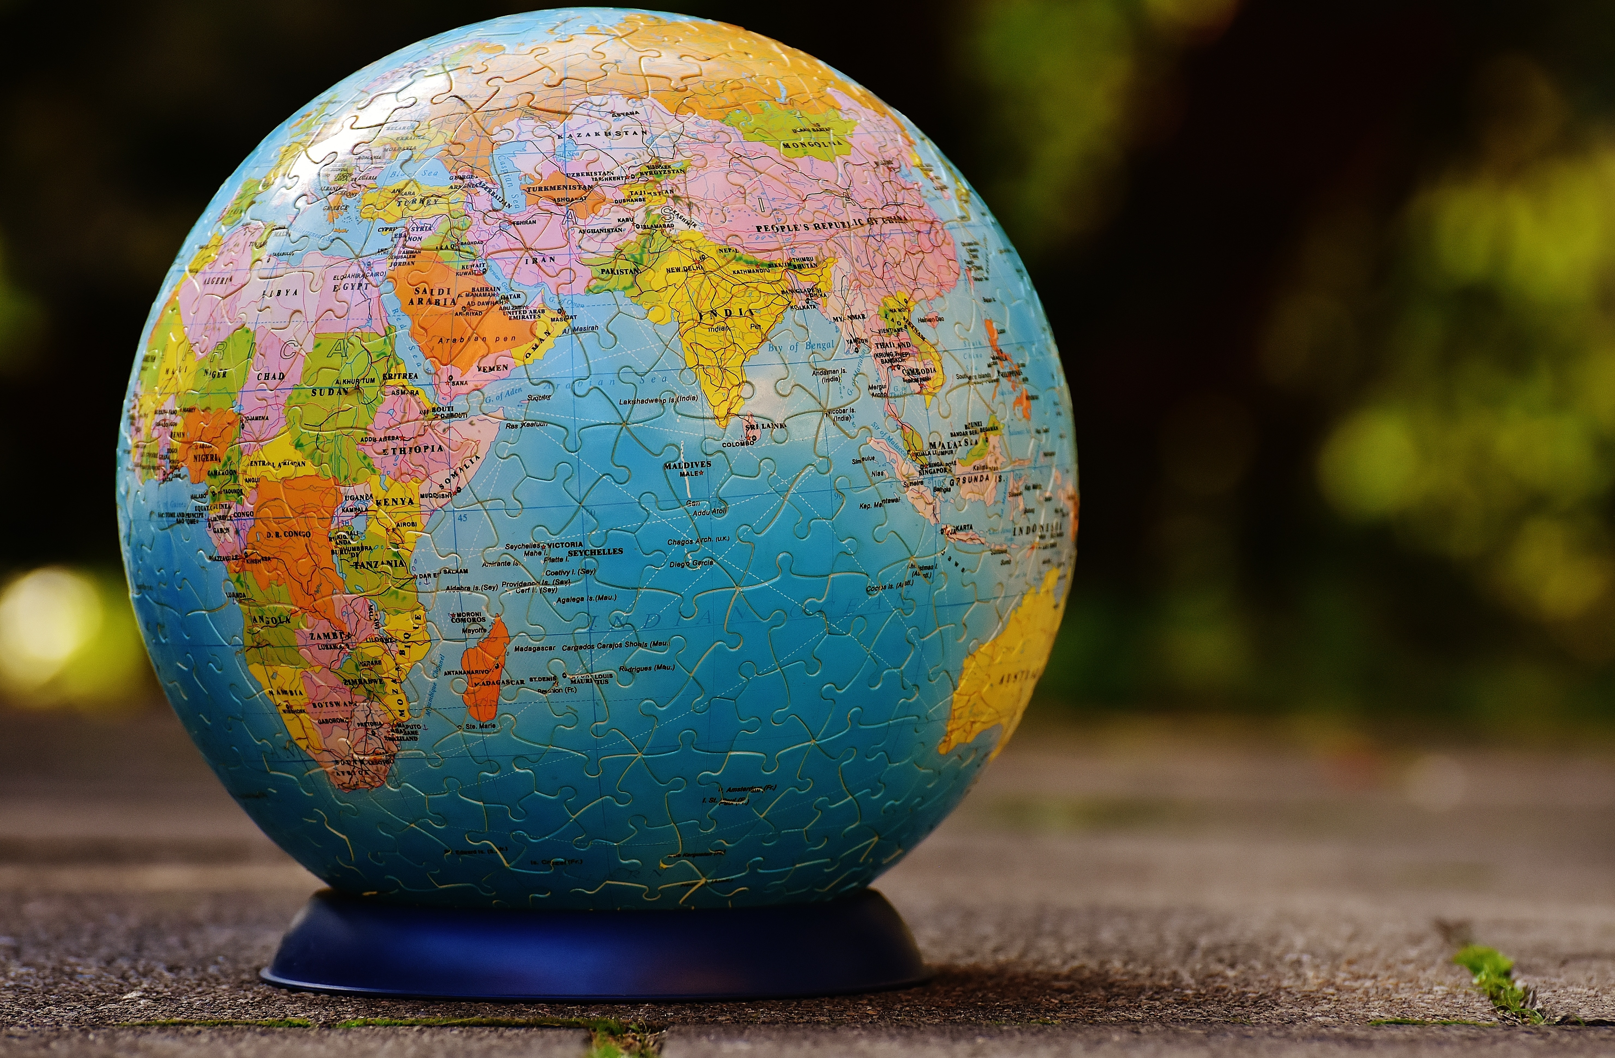
What Is Global disease biology?
Global Disease Biology is the study of One-Health, as well as the concepts of disease, the societal and personal impacts of the past, present, an future diseases, and the science behind disease discoveries, causes, evolution, diagnosis, treatment, and prevention.
Does that sound like a lot of complicated things? Don’t worry, we will break it down!
Notes:
Insert a picture illustrating a season in your country.

Slide 6
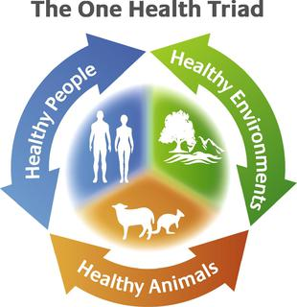
Break it down: One-health
Specifically, One-Health is:
“…the collaborative effort of multiple health science professions, together with their related disciplines and institutions – working locally, nationally, and globally – to attain optimal health for people, domestic animals, wildlife, plants, and our environment.”
-One Health Commission
Basically, it is the interconnectedness of people, plants, animals, and the environment, and how health and disease flow through them!
Notes:
Insert a picture of an animal and or plant found in your country.

Slide 7
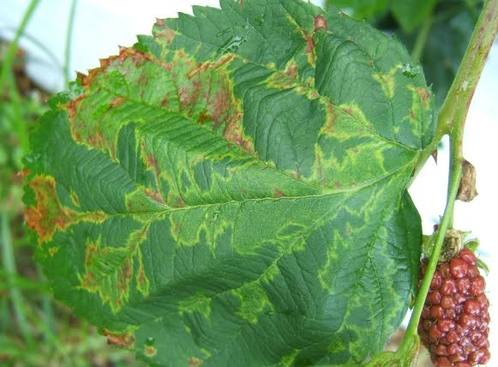
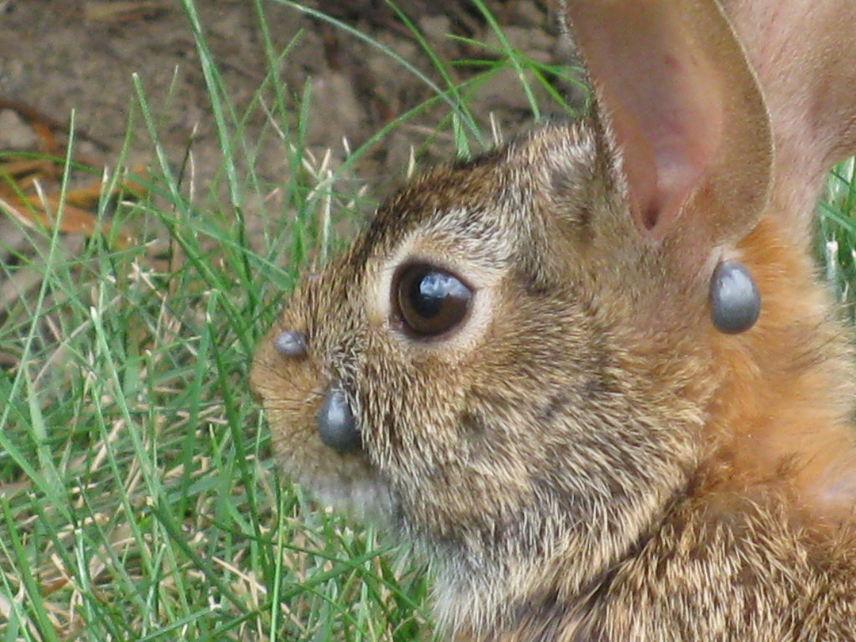
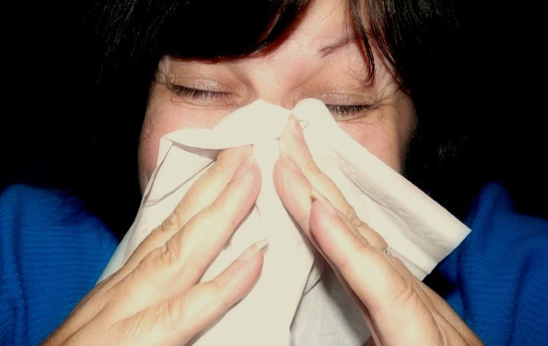
Break it down: disease
Disease is commonly defined as:
“a disorder of structure or function in a human, animal, or plant, especially one that produces specific signs or symptoms or that affects a specific location and is not simply a direct result of physical injury.”
Notes:
Add key points in the history of your country to the timeline.

Slide 8


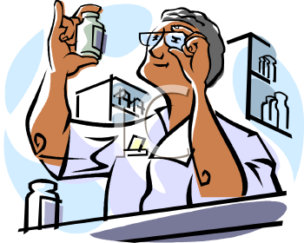
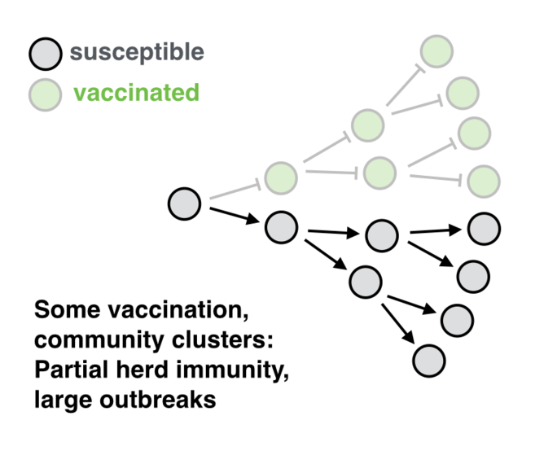
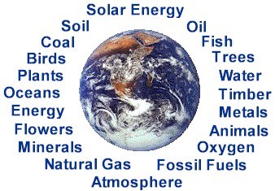

Break it down: societal impacts
It’s not just individual health that can be impacted by disease. Here are some of the other impacts you will study:
Environmental
Economic
Societal
Resource Allocation
Policy
Prioritization of resource use
Prevention vs. Cure
Notes:
Insert a picture illustrating a custom or tradition here.

Slide 9
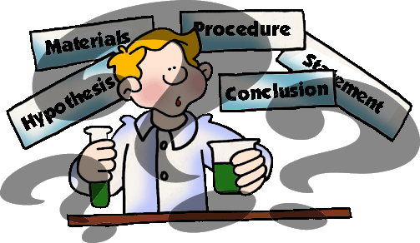
Break it down: science
The root of all of everything we have discussed, is science. Science informs policy, societal reaction, discoveries, causes, and prevention.
Resources like the scientific method, scientific reasoning, and scientific literature will become your best friends!
Notes:
Insert a picture of the head leader of your country.

Slide 10

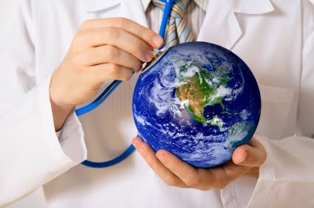
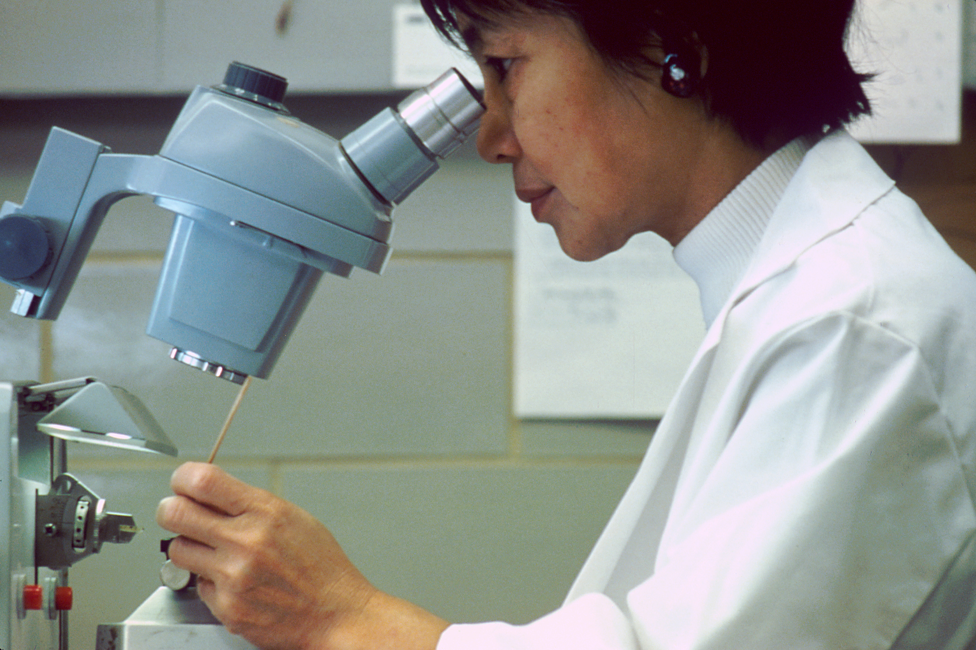
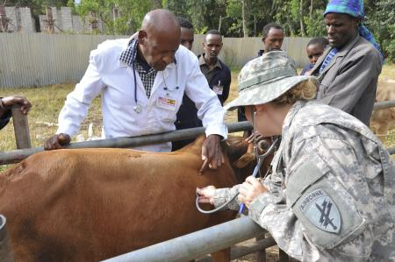

What can I do with a B.S in GDB?
So now that you know what Global Disease Biology is, what can you do with your degree?
It’s up to you! Whether it be working in Policy, going into Public Health, becoming a Plant Pathologist, or working with Environmental Safety, there is something for everyone.
Notes:
Insert a picture that illustrates some part of your country’s economy.

Slide 11

What to do from here:
Take the quizzes associated with this presentation.
Complete the following modules (and the associated quizzes):
First Year Specific Materials OR Transfer Specific Materials
General Resources Guide
All About Pass Times
What are Restricted Electives?
What is the Practicum Project?
Wrap-Up
Explore websites like OASIS, MyUCDavis, and Schedule Builder.
Make an appointment with our advising office by emailing gdb-advise@ucdavis.edu with the subject line “Orientation 2020 Advising Appointment.”
Be sure to include the code word, found in one of the presentations!
Register for classes!
Remember this can only be done AFTER your advising appointment!!
Be sure to include the code word, found in one of the presentations!
Notes:
Insert a picture of one of the points of interest for your country.

Slide 12

You can find a printable to-do list attached to this module!

