Slide 1
First Year PowerPoint and orientation materials
Orientation 2020 | First Year Students| PowerPoint and Orientation Materials
Notes:
First Year Powerpoint and Orientation Materials
First year powerpoint
Include info about what classes to take for placement test scores
Reference materials
Placement test sheet
Student housing contact information
GE sheet (list Dean’s office as referral center)

Slide 2
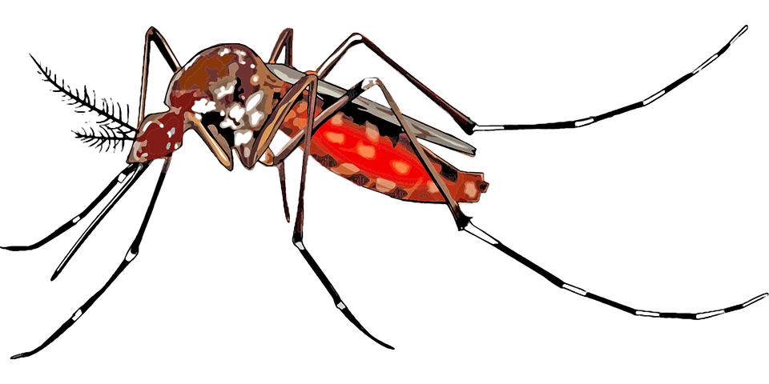
GDB CORE COURSES
GDB Lower Division:
GDB 90: Introduction to Global Disease Biology
SAS 13: Disease and Society
GDB Upper Division:
PMI 129Y: One Health – Human, Animal, & Environment Interfaces
VME 158: Infectious Disease in Ecology & Conservation
GDB 101: Epidemiology
GDB 102: Disease Intervention & Policy
Pathogen & Disease Courses:
PLP 120: Introduction to Plant Pathology
PLP 130: Fungal Disease and Biology
MIC 162: General Virology or PMI 128: Biology of Animal Viruses
PMI 127: Medical Bacteria and Fungi
ENT 153: Medical Entomology
ENT 156: Biology of Parasitism
GDB 103: The Microbiome of People, Animals, and Plants
Notes:
Insert a map of your country.

Slide 3
Other Required Coursework
Lower Division:
CHE 2A-C: General Chemistry
CHE 8A-C (or CHE 118A-C): Organic chemistry course of your choice
BIS 2A-C: Introduction to Biology
PHY 7A-B: General Physics
MAT 17A-C: Calculus for Biology and Medicine
STA 13 (or STA 100 or PLS 120): Statistics course of your choice
Upper Division:
BIS 101: Genes and Gene Expression
BIS 105 (or BIS 102-3): Biochemistry course of your choice
EVE 100: Introduction to Evolution
Mic 102-103L: Introduction to Microbiology and Lab

Slide 4
Restricted electives
At least 25 units of other classes of your choice! More on this later on in the orientation presentations.

Slide 5
General Education Coursework
Topical Breadth: 52 units required
Arts and Humanities: 12 to 20 units
Science and Engineering: 12 to 20 units
Social Sciences: 12 to 20 units
Notes:
Need to add detail?

Slide 6
General Education Coursework
Core Literacies: 35 units required
Literacy with Words and Images: 20 units
a. English Composition (as specified by your college): 8 units
b. Writing Experience coursework in your major or in other departments: 6 units
c. Oral Skills coursework or additional writing experience coursework: 3 units
d. Visual Literacy coursework: 3 units
Civic and Cultural Literacy: 9 units
a. American Culture, Governance & History: 3 units*
b. Domestic Diversity: 3 units*
c. World Cultures: 3 units*
Quantitative Literacy: 3 units
Scientific Literacy: 3 units
Notes:
Need to add detail?

Slide 7
College composition requirement
The College of Agricultural and Environmental Sciences (CA&ES) requires 2 English Composition courses in addition to GEs.
They offer 2 ways to fulfill this requirement:
1. Two Courses emphasizing writing or speaking skills
2. AP Credit & One Writing/Speaking course
3. English Composition Examination
Please note: if you need help understanding what you specifically need to do to satisfy these requirements, please as the Dean’s Office!

Slide 8
Placement Tests
Placement tests are mandatory, please stay on the lookout for emails regarding how to access the tests
Chemistry Placement Requirement
CHE 2A: Score of 24+
CHE 2AH (Honors): Score of 33+
https://chemistry.ucdavis.edu/undergraduate/general-chemistry-series/chemistry-placement-requirements/fall-2019
Math Placement Exam
MAT 17A: Score of 30+ with Trigonometry Sub-Score of 2+
https://www.math.ucdavis.edu/undergrad/math_placement
Please be sure to take your tests long before it comes time to register for courses and take these tests seriously as they directly determine the courses that you will be permitted to enroll in
Notes:
Talk about how they will take the Workload courses if they don’t place

Slide 9
Standard First-Year plan
Fall | Winter | Spring
CHE2A | CHE2B | CHE2C
MAT17A | MAT17B | MAT17C
GE (General Education) | SAS 13 | GDB 90
FYAC/First Year Seminar | GE | (ELWR) English Course
Please keep in mind that your schedule will not be the same as everyone else’s, the above is just a very generic sample!

Slide 10
Standard First-Year plan: Continued
Things to keep in mind:
Our major is intensive, the pace is up to you
Keep track of your mental health and overall readiness for university
Be honest with your own abilities (both strengths and weaknesses) academically
Tutoring is always an option
You have a network here to support you

Slide 11
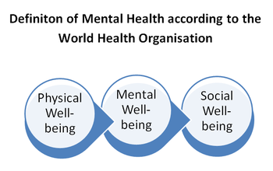
Resources and some Honesty
Resources:
housing.ucdavis.edu
Resident Advisors (RAs) are full of information and it is their job to support you, utilize them
aggiecompass.ucdavis.edu
Basic needs center!
shcs.ucdavis.edu
Student Health and Counseling Services
opportunity.ucdavis.edu
Living away from home (possibly for your first time) can lead to a mix of emotions. You may love the freedom and be having the time of your life and your roommate could be horribly homesick. Everyone is going through their own experience so remember to be kind, reach out when you can and take care of your mental health.

Slide 12
A cool opportunity!
If you’re a little nervous about adjusting to Davis, finding a research opportunity, how to build confidence, or just in general, consider joining our First Year Aggie Connection:
You ‘n Research!
We focus on creating opportunities to help you find a lab or research project!
Mock Interviews
Reviewing scientific papers
Group advising sessions
Drafting emails to professors
Creating and fostering CONFIDENCE!

