Slide 1
Transfer PowerPoint and Orientation Materials
Orientation 2020 | Transfer Students| PowerPoint and Orientation Materials

Slide 2
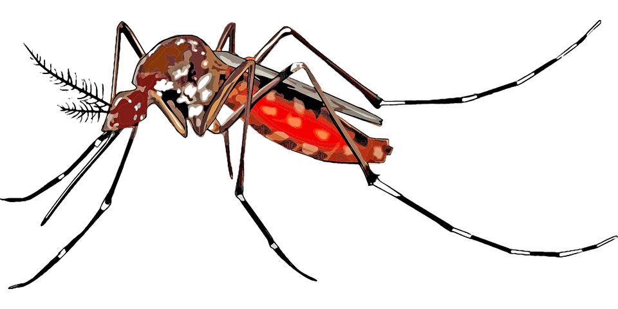
GDB CORE COURSES
GDB Lower Division:
GDB 90: Introduction to Global Disease Biology
SAS 13: Disease and Society
GDB Upper Division:
PMI 129Y: One Health – Human, Animal, & Environment Interfaces
VME 158: Infectious Disease in Ecology & Conservation
GDB 101: Epidemiology
GDB 102: Disease Intervention & Policy
Pathogen & Disease Courses:
PLP 120: Introduction to Plant Pathology
PLP 130: Fungal Disease and Biology
MIC 162: General Virology or PMI 128: Biology of Animal Viruses
PMI 127: Medical Bacteria and Fungi
ENT 153: Medical Entomology
ENT 156: Biology of Parasitism
GDB 103: The Microbiome of People, Animals, and Plants
Notes:
Insert a map of your country.

Slide 3
Other Required Coursework
Lower Division:
CHE 2A-C: General Chemistry
CHE 8A-C (or CHE 118A-C): Organic chemistry course of your choice
BIS 2A-C: Introduction to Biology
PHY 7A-B: General Physics
MAT 17A-C: Calculus for Biology and Medicine
STA 13 (or STA 100 or PLS 120): Statistics course of your choice
Upper Division:
BIS 101: Genes and Gene Expression
BIS 105 (or BIS 102-3): Biochemistry course of your choice
EVE 100: Introduction to Evolution
Mic 102-103L: Introduction to Microbiology and Lab

Slide 4
Placement Tests
Placement tests are mandatory if you are starting the MAT 16, 17, or 21 series, or the CHE 2 series.
This means, if you have never taken calculus or inorganic chemistry, you will have to take the placement tests for these courses.
NOTE: If you have already taken the equivalent of MAT 16, 17, or 21A or CHE 2A, no placement test is needed.
Chemistry Placement Requirement
CHE 2A: Score of 24+
CHE 2AH (Honors): Score of 33+
https://chemistry.ucdavis.edu/undergraduate/general-chemistry-series/chemistry-placement-requirements/fall-2019
Math Placement Exam
MAT 17A: Score of 30+ with Trigonometry Sub-Score of 2+
https://www.math.ucdavis.edu/undergrad/math_placement
Please be sure to take your tests long before it comes time to register for courses and take these tests seriously as they directly determine the courses that you will be permitted to enroll in

Slide 5
Restricted electives
At least 25 units of other classes of your choice! More on this later on in the orientation presentations.

Slide 6
General education (GE) coursework
GEs have 2 main categories:
1. Topical Breadth (52 units)
Arts and Humanities: 12 to 20 units
Science and Engineering: 12 to 20 units
Social Sciences: 12 to 20 units
2. Core Literacies (35 units)
Literacy with Words and Images: 20 units
a. English Composition (as specified by your college): 8 units
b. Writing Experience coursework in your major or in other departments: 6 units
c. Oral Skills coursework or additional writing experience coursework: 3 units
d. Visual Literacy coursework: 3 units
Civic and Cultural Literacy: 9 units
a. American Culture, Governance & History: 3 units*
b. Domestic Diversity: 3 units*
c. World Cultures: 3 units*
Quantitative Literacy: 3 units
Scientific Literacy: 3 unit
See the video for more! Also, remember that the CA&ES Dean’s office is your go-to for all things GE!
Did you IGETC?
If yes, you’re all set! Just make sure that the college has received your IGETC paperwork
You can check via admissions@ucdavis.edu
If no, read on!
Notes:
Insert a picture of an animal and or plant found in your country.

Slide 7
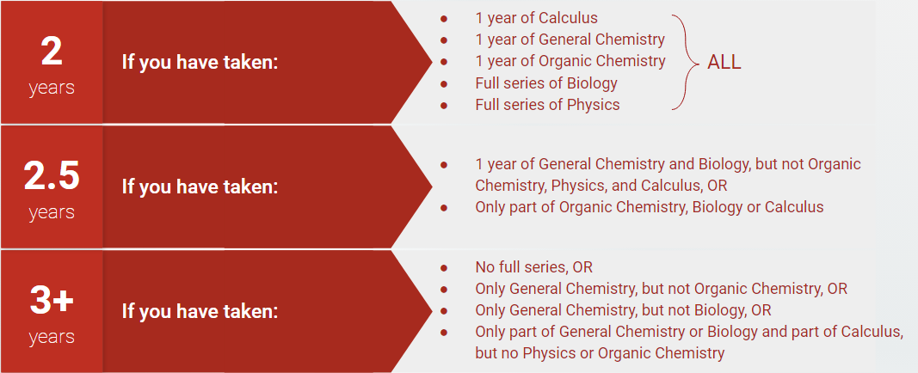
How long will it take to finish my degree?

Slide 8
How many units should I take?
Generally, an average of 15 units/quarter to graduate in 4 years
Averages of 12 units/quarter to maintain minimum progress (36 units/year)
12 units/quarter is maintaining full time status
The same is 6 units total for summer sessions
Falling below can result in Academic Probation, but don’t panic!
Sample Transfer Schedule:
Notes:
Insert a picture of one of the geographic features of your country.

Slide 9
TAKE care of yourself
Things to keep in mind:
Our major is intensive, the pace is up to you
Keep track of your mental health and overall readiness for university
Be honest with your own abilities (both strengths and weaknesses) academically
Tutoring is always an option
You have a network here to support you
You belong here and we are always here to support you, especially during this transition
Mental health IS health
Notes:
Insert a picture illustrating a season in your country.

Slide 10
Transfer Frequently asked questions (FAQs)
Will I be able to complete this degree in 2 years?
That depends on what lower division work you completed at a CC! Slide 5 will give you a pretty good idea of how long the degree will take
How do I articulate the courses I have taken at a CC?
Don’t worry! We do this for you!
When you SIR, we are provided a list of coursework you took at former colleges
We take this information and hand articulate it using ASSIST and our programmatic resources
We use these articulations to create a personalized 2 year schedule for each of you!
Notes:
Insert a map of your country.

Slide 11
Transfer FAQs continued…
Will the lower division courses I took at community college count as prerequisite courses here?
Great question!
Yes, the tricky part comes when they don’t automatically articulate as the correct series.
For example, sometimes a course will articulate as BIS TR1 instead of BIS 2A if it isn’t a direct articulation
But don’t worry, there is something you can do to make your life easier, and to make it so you don’t have to fill out a million prerequisite petitions.
You can Force Articulate a course!
Notes:
Add key points in the history of your country to the timeline.

Slide 12
A cool opportunity!
If you’re a little nervous about adjusting to Davis, finding a research opportunity, how to build confidence, or just in general, consider joining out First Year Aggie Connection:
You ‘n Research!
We focus on creating opportunities to help you find a lab or research project!
Mock Interviews
Reviewing scientific papers
Group advising sessions
Drafting emails to professors
Creating and fostering CONFIDENCE!

