Slide 1

Global Disease Biology General Resource Guide
Orientation 2020 | Freshman & Transfer Students| Resource Guides

Slide 2

Campus Resources Introduction
As an undergraduate student at UC Davis, you will have access to a multitude of both on and off campus resources
Note that the resources provided to you in this presentation will include both in person and online options, which will be denoted as such.
We will cover:
Commonly used advising websites
Health and Wellness Resources
Academic Resources
Research and Internship Resources
Peer Reviewed and Recommended Resources
Notes:
Insert a map of your country.

Slide 3
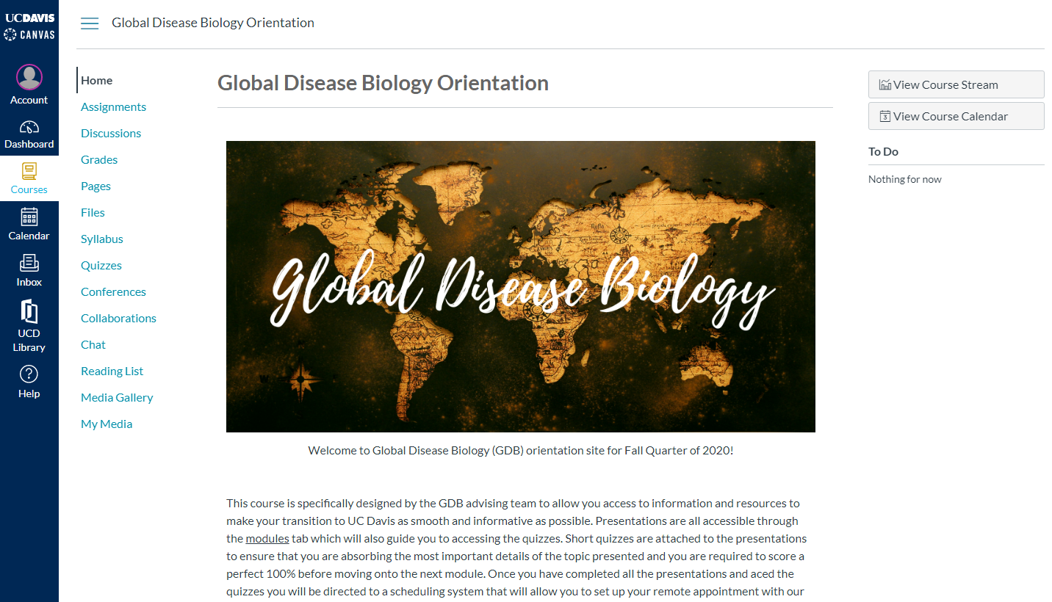
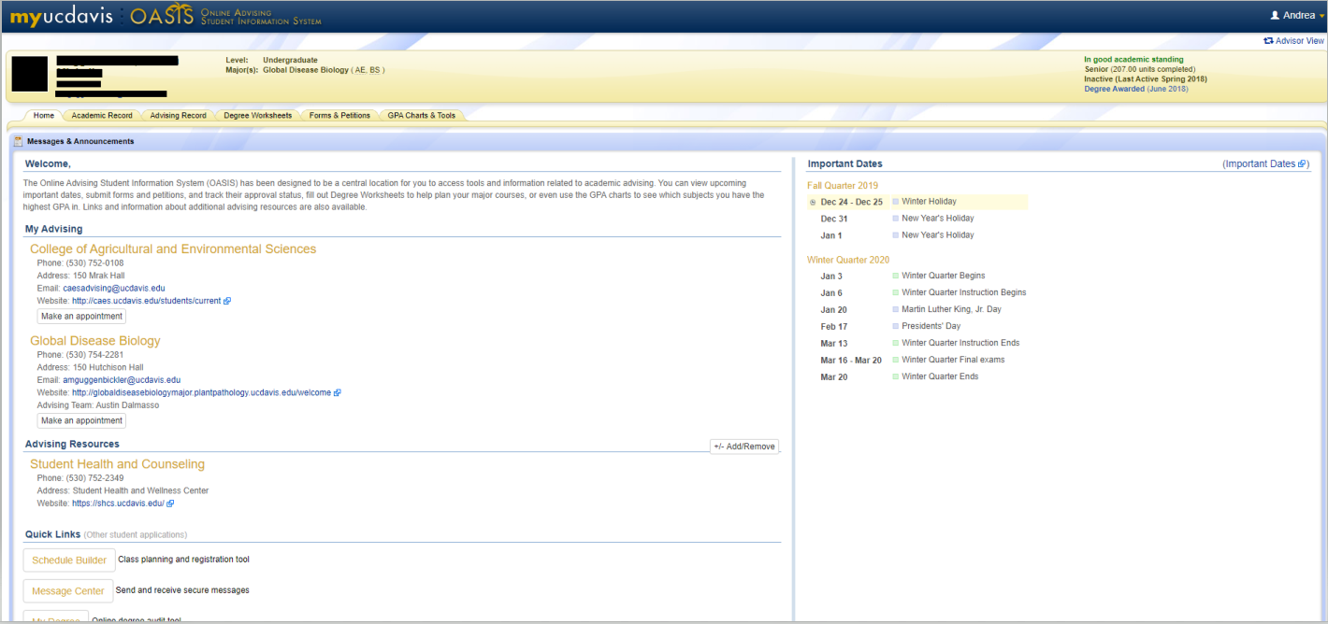
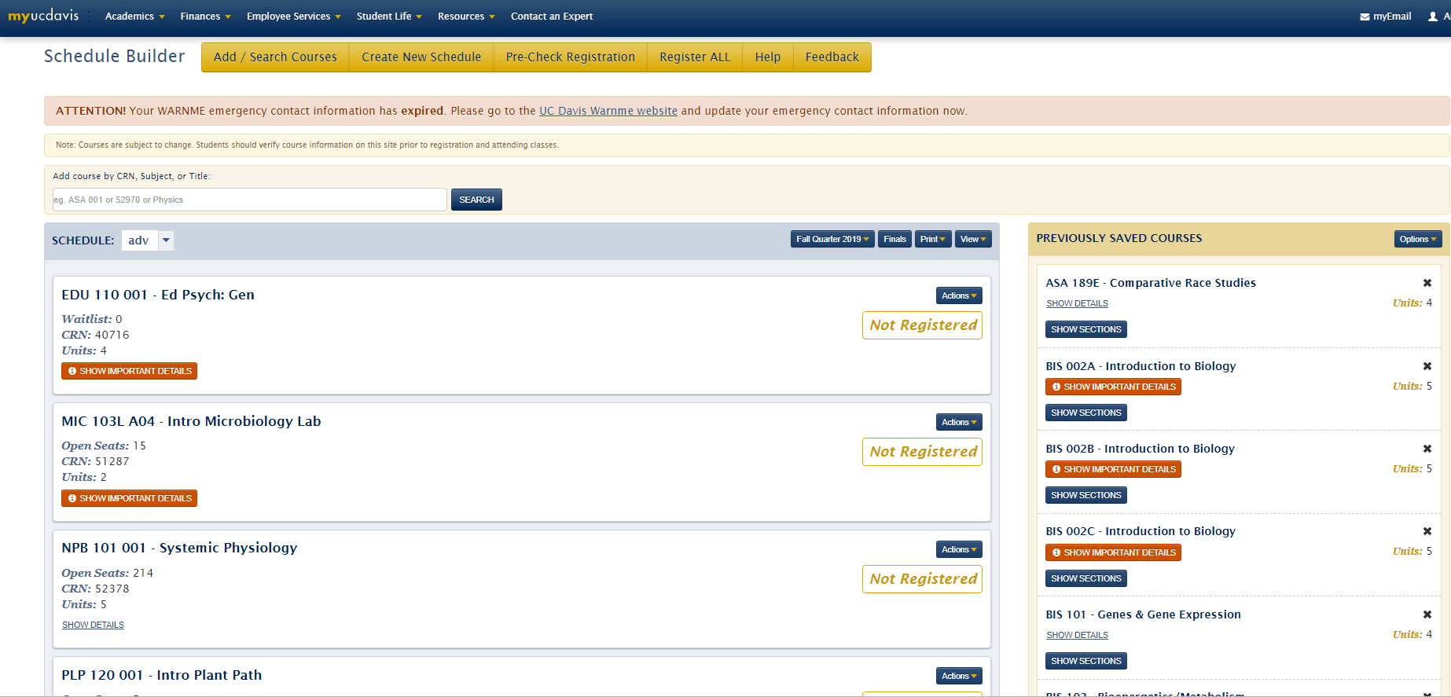
Advising Websites
CANVAS
Canvas.ucdavis.edu
You’re on it now! Class websites are on the homepage, most commonly used website
OASIS
Oasis.ucdavis.edu
Academic Record, Advising Record, Degree Worksheet, Forms and Petitions (Academic Plans), and GPA Charts and Tools, Appointment Scheduling
Schedule Builder
My.ucdavis.edu/schedulebuilder
Class scheduling, prerequisite checking, links to the catalog
Notes:
Insert a picture of one of the geographic features of your country.

Slide 4
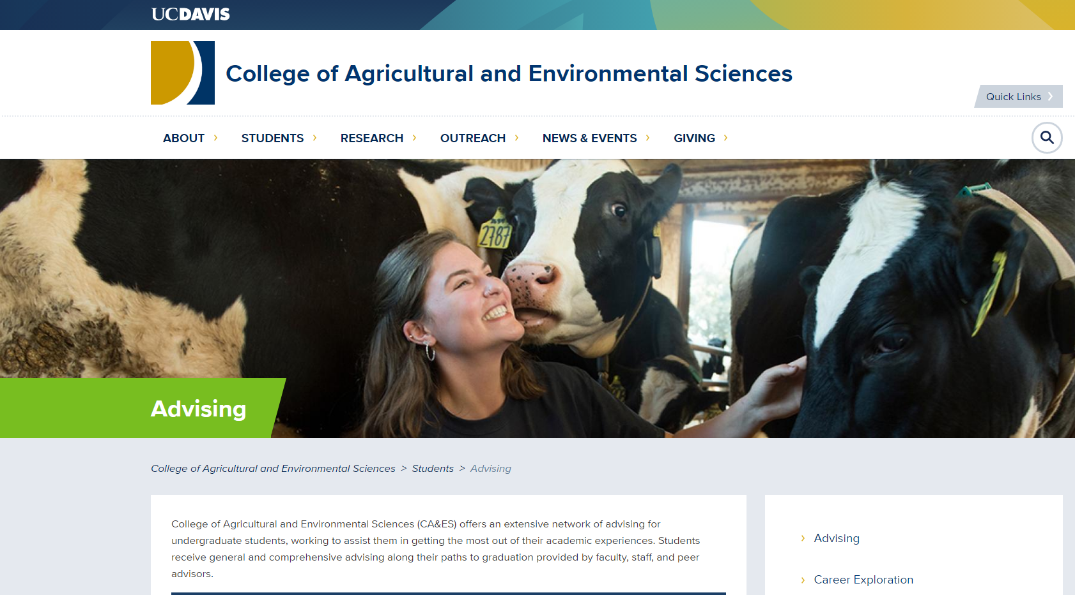
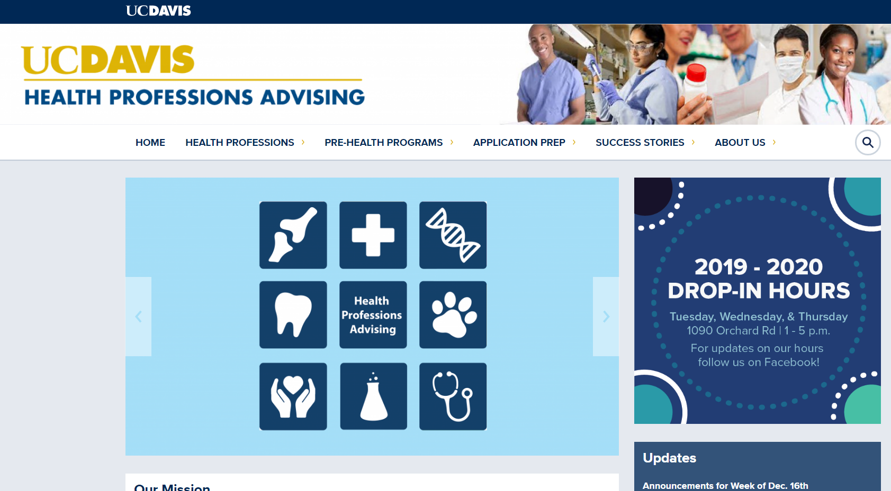
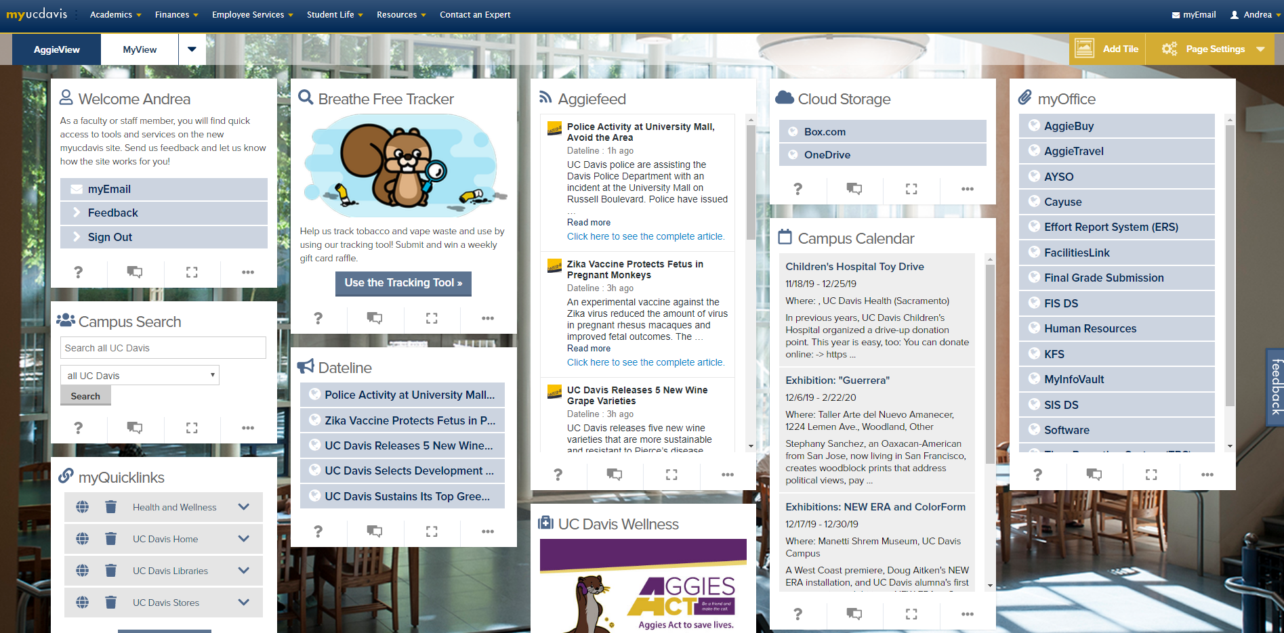
Advising Websites Continued…
CA&ES Advising Website
Caes.ucdavis.edu/students/advising
Access to GE advisors, make appointments with a Dean’s office advisor
Health Professions Advising
Hpa.ucdavis.edu
Also known as HPA, provides access to advisors for students interested in health professions, resources for GRE, MCAT, LSAT studying, interview prep, etc.
MyUCDavis
My.ucdavis.edu
Central hub for all things UC Davis, links to all of the above mentioned resources, also accesses MyBill, MyAwards, etc.
Notes:
Insert a picture illustrating a season in your country.

Slide 5
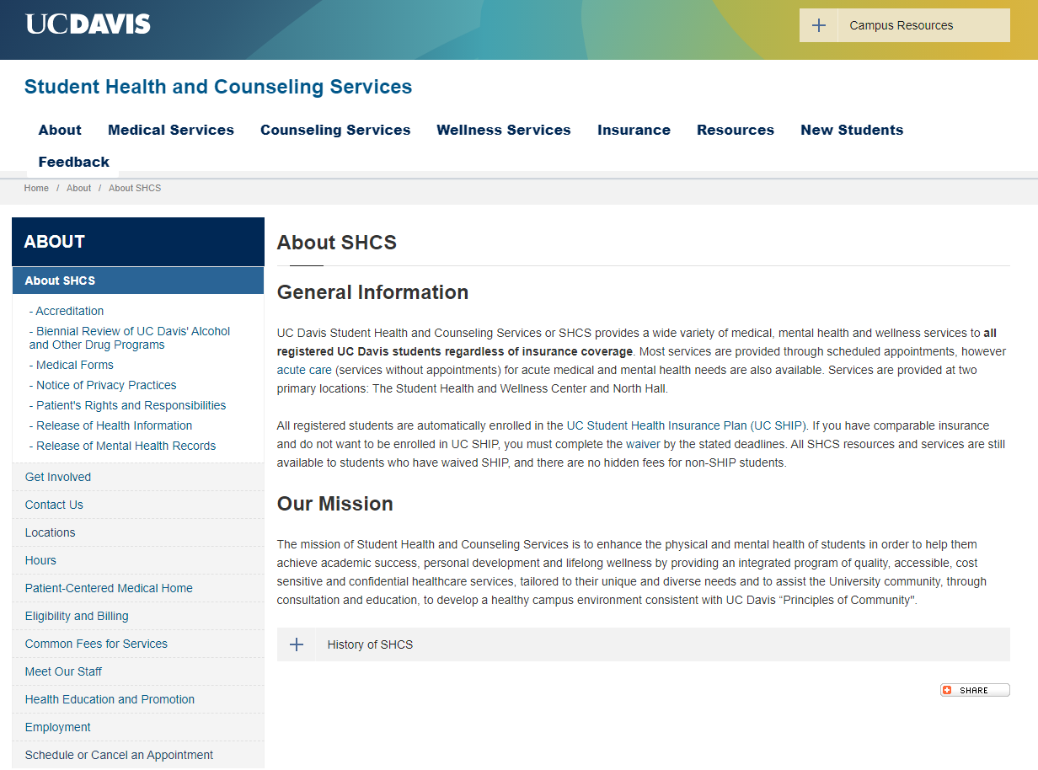
Health & wellness resources
Student Health and Counseling Services
Student Health and Wellness Center (Medical Services)
Counseling Services at 219 North Hall (Counseling Services)
You can either go in person, or go online to schedule and appointment!
Their goal is to enhance the physical and mental health of students to help them succeed!
Notes:
Insert a picture of an animal and or plant found in your country.

Slide 6
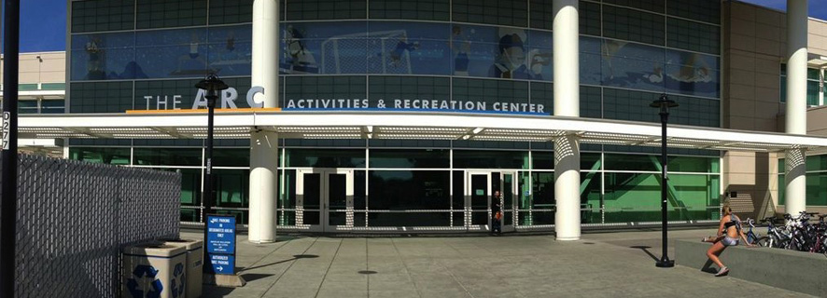


Health & wellness resources Continued…
Activities and Recreation Center (ARC)
Free access for students! Offers things like group exercise classes, personal training, series classes, and rec sports.
Center for Advocacy, Resource, and Education (CARE)
Provides case managers and resource access for distressed students, and works to help create a community free of sexual and gender-based violence
Aggie Compass and the Pantry
Student community space to find fresh fruits and veggies, assistance with CalFresh enrollment, and resources to find stable housing and finances.
Notes:
Add key points in the history of your country to the timeline.

Slide 7
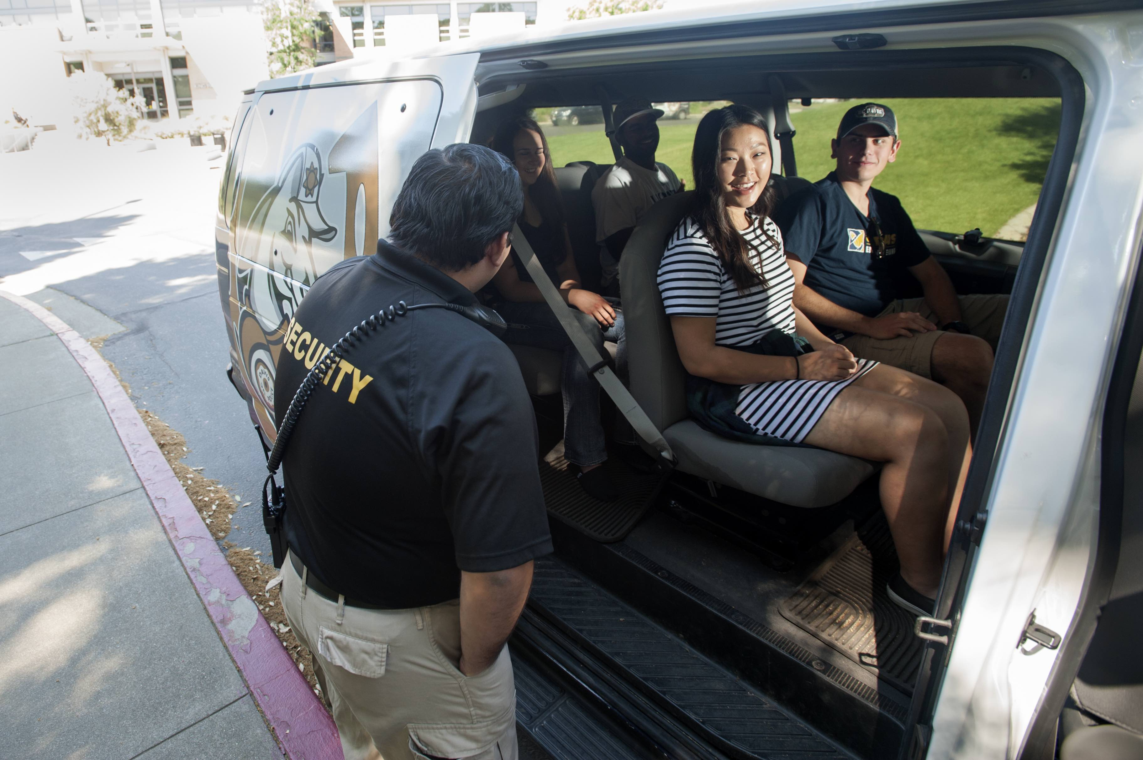
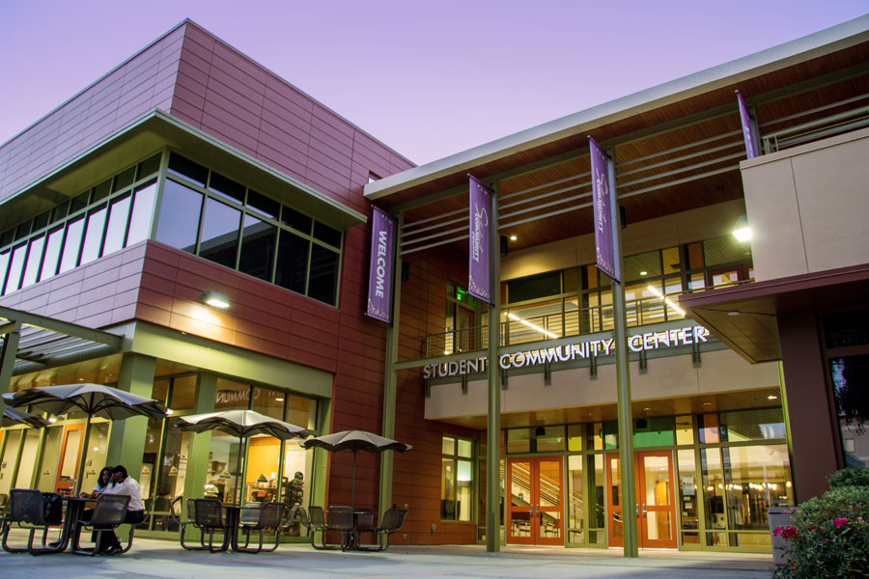
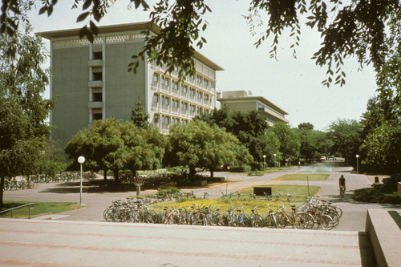
Health & wellness resources Continued…
UCDPD Safe Rides
Phone number: (530)754-2677
Available to anyone, 7 days a week from 5pm to 10pm on campus to another location on campus, and 10pm-6am for on campus pick up to any location in the city of Davis.
Student Community Center and Counselors
Home to many centers on campus! Examples: AB540 Undocumented Students Center, Cross Cultural Center, LGBTQIA+ Resource Center, URC, Student Recruitment and Retention Center, Women’s Resource and Research Center
Our office!
At 150 Hutchison Hall, we offer a student pantry, academic advising, a listening ear, peer advice, and a place to decompress and gain a community
Notes:
Insert a picture illustrating a custom or tradition here.

Slide 8
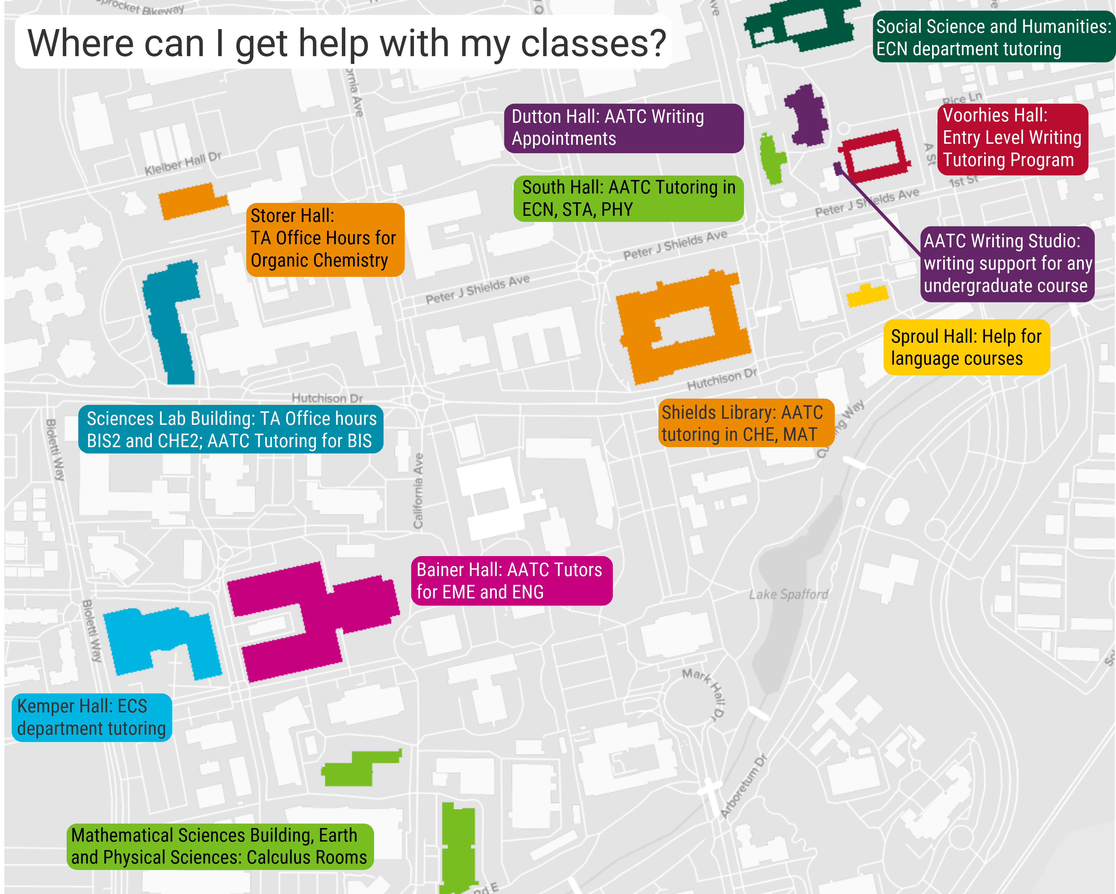
Academic resources
Academic Assistance and Tutoring Centers (AATC)
Tutoring.ucdavis.edu
Transfer & Re-Entry Center (TRC)
Opportunity.ucdavis.edu/centers/trc
Student Disability Center (SDC)
Sdc.ucdavis.edu
Community Resource and Retention Center (CRRC)
Studentaffairs.ucdavis.edu/student-life/crrc
Office of Educational Opportunity & Enrichment Services (OEOES)
Opportunity.ucdavis.edu
Office of Student Support and Judicial Affairs (OSSJA)
Ossja.ucdavis.edu/mission-functions
Notes:
Insert a picture of the head leader of your country.

Slide 9
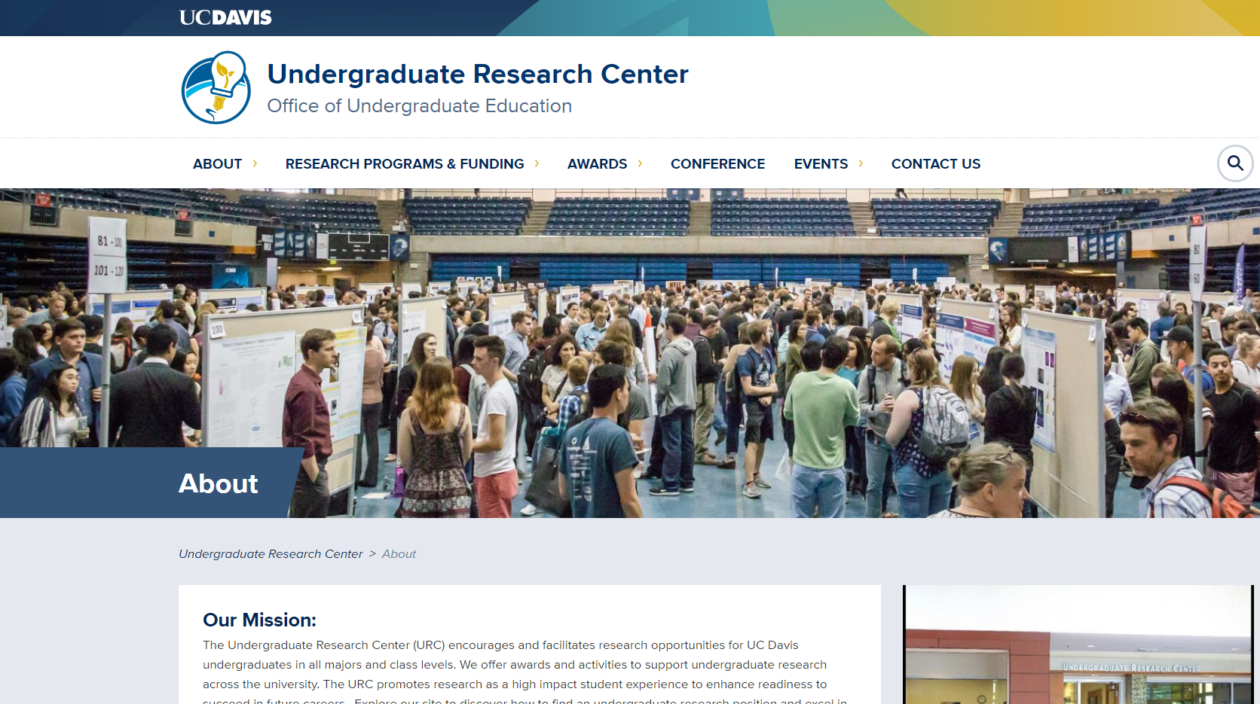
Research & Internships Resources
Undergraduate Research Center (URC)
Portal for helping students to locate research opportunities
Host an undergraduate research conference each year (many of our students participate!)
Award and scholarship opportunities
Fellowship opportunities
Encourages and facilitates research for undergraduate students at all levels
Offer advising, info sessions, and funding!
Notes:
Insert a picture that illustrates some part of your country’s economy.

Slide 10
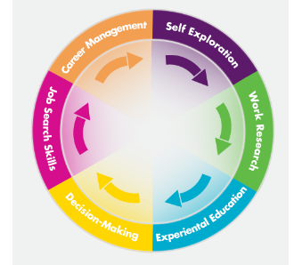
Research & Internships Resources
Internship and Career Center (ICC)
Resume and cover letter workshops
One on one advising
Interview help and job offer review
Helps students find jobs and internships
Career planning
Works with all populations of students!
Notes:
Insert a picture of one of the points of interest for your country.

Slide 11


Research & Internships Resources
Other Resources:
Handshake
Medical Center and Health Related Internships (HRI)
Associated Students, University of California Davis (ASUCD)
Student Run Clinics (SRCs)
UC Davis Washington Program (UCDC)
Study Abroad Internships

Slide 12

Peer Reviewed and recommended resources
Shields Library
Great quiet place to study! (3rd and 4th floor are silent study areas, while the basement, 1st, and 2nd floors are group study)
Women’s Resource Center
Promote gender equity and social justice. Offers education programs and workshops
Health Education and Promotion
Drop-ins for all students to help achieve wellness through education and health promotion
Center for Leadership Learning
Workshops, certificate programs, and events
Memorial Union
Study spaces, lost and found, gaming area, student pantry, veteran’s success center, coffee house, amazon lockers, campus store, student disability drop in center, aggie card office, lactation room, legal services

Slide 13
Bonus resource: the global disease biology academic advising office
Located in 150 Hutchison Hall
Drop-In Hours are 9am-4pm M-F
Peer Advisor Hours will be sent out at the beginning of each quarter
What do we provide?
Academic Advising
Scheduling help
Student Pantry
A listening ear
Student experience
Example practicums
Help determining Restricted Electives
Academic difficulty counseling
Practicum Project assistance
Internship forms
We want to see you at least once per quarter!!!

