Slide 1

Restricted Electives
Orientation 2020 | First Year and Transfer Students| Restricted Electives

Slide 2


What is a restricted elective?
Restricted Electives (REs) are a set of, typically, upper division-courses with a combined minimum of 25 units that you as a GDB student get to pick and choose!
These units give students the opportunity to personalize the Global Disease Biology degree and explore the fields of health and disease in a way that you are passionate about.
Notes:
Insert a map of your country.

Slide 3

How to choose your Restricted electives
There are rules, which are detailed in the “Guide to Restricted Electives” which is attached to this module.
Ask yourself some questions:
What courses best fit your interests?
What courses will help prepare you for your intended career?
What courses would you want to highlight in an application for grad, med, or vet school?
What courses complement your GDB Practicum?
Notes:
Insert a picture of one of the geographic features of your country.

Slide 4

When to start choosing restricted electives
As soon as you enter the major! There are several ways to find courses:
The UC Davis course catalog
Talk to fellow GDB students
Ask peer advisors for opinions
Review Appendix A of this document
Talk with a faculty advisor or your practicum mentor
You’ll get your chosen courses approved in GDB 187, which you will probably take your Junior year!
Notes:
Insert a picture illustrating a season in your country.

Slide 5

Restricted elective rules
Restricted electives are approved as a whole list, not as individual courses
Advising staff can tell you what they think will count as REs, but to get formal approval, you must use an RE approval sheet with justification.
An exception to this are the courses listed in Appendix A.
These do not need an approval form
There is a list of 9 rules (and exceptions) listed in the Guide- PLEASE READ THEM.
The most important rule? Don’t take Restricted Electives for Pass/No Pass grades.
Notes:
Insert a picture of an animal and or plant found in your country.

Slide 6

Appendix A
This section lists the courses that you do not need prior approval in order to take. All of these courses have been taken by numerous GDB students!
You should still let an advisor know you plan to take them so we can advise you on the difficulty level, quarters offered, and any personal experience with the class!
Appendix A is a great resource when you are just starting out!
A note: your REs do not have to come from Appendix A. They can be any class that is science or science-adjacent that goes along with either what you want to do after college, or with your practicum project. Don’t limit yourself!
Notes:
Add key points in the history of your country to the timeline.

Slide 7
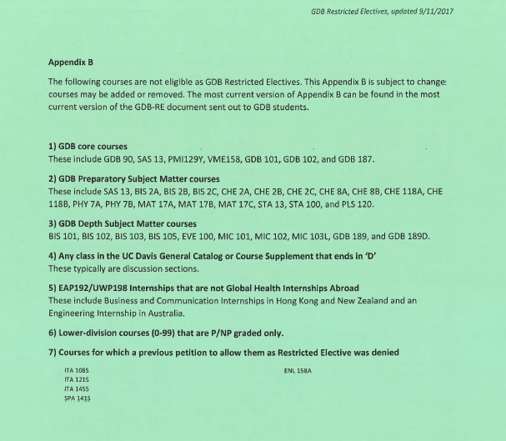
Appendix b
Appendix B includes all of the courses that are NOT eligible to be used as GDB restricted electives. This could be for a variety of reasons:
It is a required course for the major
It is a discussion section
It is an abroad internship that is not Global Health related
It is lower division that is P/NP only
Previously denied Restricted Electives
These courses cannot be counted as Restricted Electives, and the list is subject to change.
Notes:
Insert a picture illustrating a custom or tradition here.

Slide 8

Restricted Elective Examples
SPH 101- Introduction to Public Health (3)
MMI 188- Human Immunology (3)
SAS 109- Environmental Change, Disease, and Policy (4)
ANT 129- Global Health & Medicine (4)
NPB 101- Systemic Physiology (5)
FST 104- Food Microbiology (3)
CHI 114- Reproductive Health (4)
PLP 140- Ag Biotech and Public Policy (4)
PLS 152- Plant Genetics (4)
POL 109- Public and Governmental Policy (4)
IDI 141- Infectious Diseases
Notes:
Insert a picture of the head leader of your country.

Slide 9

Overall your restricted electives are up to you!
Remember to utilize your academic advisors and practicum mentor to help you pick your REs.
We have been in your shoes!
We can help direct your interests into coursework.
We have extensive knowledge of when courses are taught, and how often they are offered.
It’s our job!
Remember, it is your education and your journey!
Notes:
Insert a picture that illustrates some part of your country’s economy.

